Slide 1





Built-in Functions
Functions and Wildcards
in MySQL Server
Functions
& Wildcards
SoftUni Team
Technical Trainers
Software University
http://softuni.bg

Slide 2

Table of Contents
Function Overview
String Functions
Math Functions
Date Functions
Wildcards

Slide 3
Questions
sli.do #MYSQL

Slide 4

Functions in MySQL Server

Slide 5

SQL Functions
String Functions – for manipulating text, both from table values or user input
E.g. concatenate column values
Math Functions – calculations and working with aggregate data
E.g. perform geometry and currency operations
Date and Time Functions
E.g. find length of timespan
Miscellaneous Functions

Slide 6

String Functions

Slide 7
String Functions
SUBSTRING – extract part of a string
Example: get short summary of article
SUBSTRING(String, Position, Length)
Index is 1-based!
SELECT `article_id`, `author`, `content`,
SUBSTRING(`content`, 1, 200) AS 'Summary'
FROM `articles`;

Slide 8
String Functions (2)
REPLACE – replace specific string with another
Example: censor the word blood from album names
REPLACE(String, Pattern, Replacement)
SELECT REPLACE(`title`, 'Balls', '*****')
AS 'Title'
FROM `album`;

Slide 9
String Functions (3)
LTRIM & RTRIM – remove spaces from either side of string
CHAR_LENGTH – count number of characters
LENGHT – get number of used bytes (double for Unicode)
LTRIM(String)
RTRIM(String)
CHAR_LENGTH(String)
LENGTH(String)

Slide 10
String Functions (4)
LEFT & RIGHT – get characters from beginning or end of string
Example: name shorthand (first 3 letters)
LEFT(String, Count)
RIGHT(String, Count)
SELECT `id`, `start`,
LEFT(`name`, 3) AS 'Shorthand'
FROM `games`;

Slide 11
Problem: Obfuscate CC Numbers
Our database contains credit card details for customers
Provide a summary without revealing the serial numbers
id | first_name | last_name | payment_number
1 | Guy | Gilbert | 5645322227179083
2 | Kevin | Brown | 4417937746396076
… | … |  | …
id | first_name | last_name | payment_number
1 | Guy | Gilbert | 564532**********
2 | Kevin | Brown | 441793**********
… | … |  | …

Slide 12
Solution : Obfuscate CC Numbers
We reveal the first 6 digits and obfuscate the rest
Bonus – create View for use by client apps
SELECT `customer_id` AS 'id',
`first_name`,
`last_name`,
CONCAT(LEFT(`payment_number`,6),'**********') AS 'payment_number'
FROM `customers`;
CREATE VIEW v_public_payment_info AS
…

Slide 13
String Functions (6)
LOWER & UPPER – change letter casing
REVERSE – reverse order of all characters in string
REPEAT – repeat string
LOWER(String)
UPPER(String)
REVERSE(String)
REPEAT(String, Count)

Slide 14
String Functions (7)
LOCATE – locate specific pattern (substring) in string
INSERT – insert substring at specific position
If omitted, begins at 1
LOCATE(Pattern, String,[Position])
INSERT(String, Position, Length, Substring)
Number of character
to delete

Slide 15

Math Functions

Slide 16
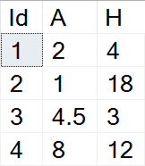
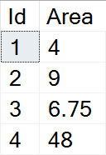
Math Functions
Basic arithmetic operations
Example: find area of triangles by given side and height
SELECT `id`,
(`a`*`h`)/2 AS 'Area'
FROM `triangles_second`;

Slide 17
Math Functions (2)
PI – get the value of Pi (15 –digit precision)
ABS – absolute value
SQRT – square root
POW – raise value to desired exponent
SELECT PI() +0.000000000000000
ABS(Value)
SQRT(Value)
POW(Value, Exponent)

Slide 18
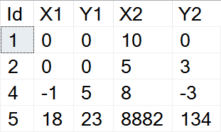
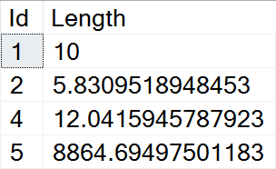
Example: Line Length
Find the length of a line by given coordinates of end points
SELECT `id`,
SQRT(POW((`X1`-`X2`),2) + POW((`Y1`-`Y2`),2))
AS 'Length'
FROM `lines`;

Slide 19
Math Functions (3)
CONV – Converts numbers between different number bases
ROUND – obtain desired precision
FLOOR & CEILING – return the nearest integer
CONV(Value,from_base,to_base)
Can be negative
ROUND(Value, Precision)
FLOOR(Value)
CEILING(Value)

Slide 20
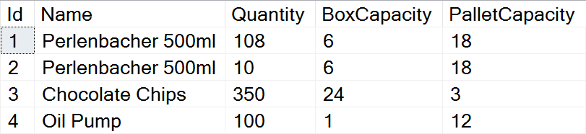
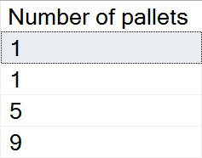
Problem: Pallets
Calculate the required number of pallets to ship each item
BoxCapacity specifies how many items can fit in one box
PalletCapacity specifies how many boxes can fit in a pallet

Slide 21
Solution : Pallets
Since we can't use half a box or half a pallet, we need to round up to the nearest integer value
SELECT
CEILING(
CEILING(
CAST(`quantity` AS DECIMAL) /
`box_capacity`) / `pallet_capacity`)
AS 'Number of pallets'
FROM `products`;

Slide 22
Math Functions (4)
SIGN – returns +1, -1 or 0, depending on value sign
RAND – get a random value in range [0,1)
If Seed is not specified, one is assigned at random
To obtain a random integer R in range i <= R < j use: FLOOR( i + RAND() * (j - i))
SIGN(Value)
RAND()
RAND(Seed)

Slide 23

Date Functions

Slide 24
Date Functions
EXTRACT – extract a segment from a date as an integer
Part can be any part and format of date or time
For a full list, see the official documentation
EXTRACT(Part FROM Date)
year, %Y, %y
YEAR(Date)
month, %M, %m
MONTH(Date)
day, %w, %D
DAY(Date)

Slide 25
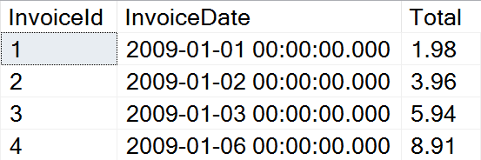
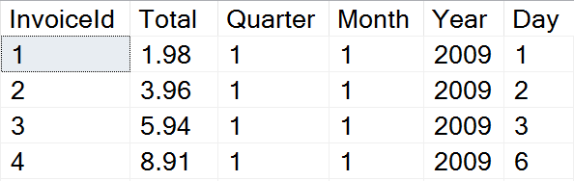
Problem: Quarterly Report
Prepare sales data for aggregation by displaying yearly quarter, month, year and day of sale

Slide 26
Solution: Quarterly Report
Use EXTRACT to get the relevant parts of the date
This statement might be useful as a View
SELECT `InvoiceId`, `Total`,
EXTRACT(quarter FROM `InvoiceDate`) AS 'Quarter',
EXTRACT(month FROM `InvoiceDate`) AS 'Month',
EXTRACT(year FROM `InvoiceDate`) AS 'Year',
EXTRACT(day FROM `InvoiceDate`) AS 'Day'
FROM invoice;

Slide 27
Date Functions (2)
TIMESTAMPDIFF – find difference between two dates
Part can be any part and format of date or time
Example: Show employee experience
TIMESTAMPDIFF(Part, FirstDate, SecondDate)
SELECT `employee_id`, `first_name`, `last_name`,
TIMESTAMPDIFF(year, `hire_date`, '2017-05-31')
AS 'Years In Service'
FROM `employees`;

Slide 28
Date Functions (3)
DATE_FORMAT – formats the date value according to the format
NOW – obtain current date and time
DATE_FORMAT(Date,Format)
SELECT DATE_FORMAT('2017/05/31', '%Y %b %D') AS 'Date';
SELECT NOW();

Slide 29

Wildcards
Selecting results by partial match

Slide 30
Using WHERE … LIKE
Wildcards are used with WHERE to filter for partial match
Similar to Regular Expressions
Example: Find all employees who's first name starts with "Ro"
SELECT `employee_id`, `first_name`, `last_name`
FROM `employees`
WHERE `first_name` LIKE 'Ro%';
Wildcard symbol

Slide 31
Wildcard Characters
Supported characters include
\ – specify prefix to treat special characters as normal
% --any string, including zero-length
_ --any single character
SELECT `TrackID`, `Name`
FROM `Track`
WHERE `Name` LIKE '%wer\!%';

Slide 32
Using Regular Expression
REGEXP - Pattern matching using regular expressions
SELECT `employee_id`, `first_name`, `last_name`
FROM `employees`
WHERE `first_name` REGEXP '^\[^K\]{3}\$';
Regular expression

Slide 33

Summary
MySQL Server provides various built-in functions
Using Wildcard, we can obtain results by partial string matches
SELECT `employee_id`, `first_name`, `last_name`,
TIMESTAMPDIFF(year, `hire_date`, '2017-05-31')
AS 'Years In Service'
FROM `employees`;

Slide 34







Built-in Functions
https://softuni.bg/courses/

Slide 35
License
This course (slides, examples, demos, videos, homework, etc.) is licensed under the "Creative Commons Attribution-NonCommercial-ShareAlike 4.0 International" license
Attribution: this work may contain portions from
"Databases" course by Telerik Academy under CC-BY-NC-SA license

Slide 36




Free Trainings @ Software University
Software University Foundation – softuni.org
Software University – High-Quality Education, Profession and Job for Software Developers
softuni.bg
Software University @ Facebook
facebook.com/SoftwareUniversity
Software University Forums
forum.softuni.bg

